Slide 1


TAG’D
TEAM BETA
Jonathan Elia • Caleb Abraham
Wesley Icer • Isabel Acosta
Rate and Review your favorite video games/media!

Slide 2

TAG’D ?
WHAT IS
TAG’D is an online forum and community where video game players and enthusiasts can discuss and debate their favorite games. Inspired by similar services like Letterboxd it allows users to review and journal their feelings on the titles they play and complete. In addition to reviewing, users will be able to go to a specific game's information page, share clips, and contribute to forum posts about questions on how to get a specific thing/achievement done in a video game.
Together, our group created the backbone set up to allow this project to move forward to implementation and potential launch.
This setup has been divided into 3 different documents:
Project Plan Document
System Requirements Document
System Design Document

Slide 3


GOAL
OUR
TAG'D is a social networking platform designed for gamers to build and express their digital identity through the games they play. The application allows users to curate a personal profile of their favorite and recently played titles, discover new games through community-driven recommendations, and engage with other players in a moderated, welcoming environment. Beyond the individual user, TAG'D also serves as a promotional channel for indie developers, offering visibility for new releases to an audience of actively engaged gamers.

Slide 4
CONTEXT DIAGRAM
USE CASE DIAGRAM
DESIGN CLASS DIAGRAM
CONTENTS
STATECHART
SEQUENCE DIAGRAMS
UI
DESIGN
01.
02.
03.
A data flow diagram (DFD) which shows the
scope of the system
Behavioral diagram that visually represents how actors interact with a system
Visually represent the structure and relationships of classes within a system
TAG’D
TABLE OF
04.
05.
06.
Visually represents the interactions between objects or components in a system over time
Used to model the dynamic behavior of a system by depicting the states an object can be in and the transitions between these states triggered by events
Our interface mockup to display how users will interact with our product

Slide 5
CONTEXT DIAGRAM
01.
Notes:
Jon - main speaker, Caleb - main speaker

Slide 6
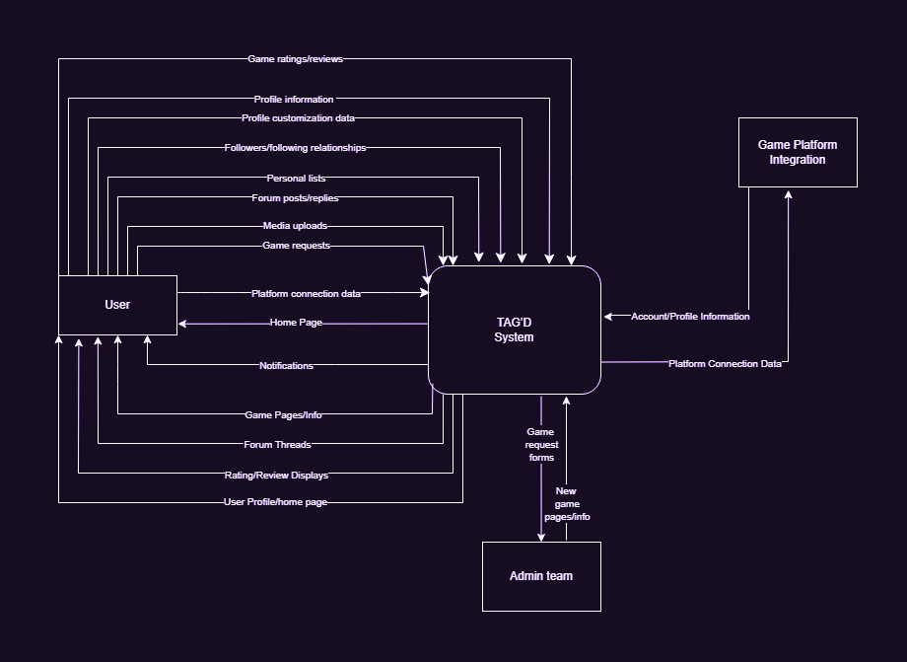
SSD:
OUR

Slide 7
USE CASE DIAGRAM
02.

Slide 8
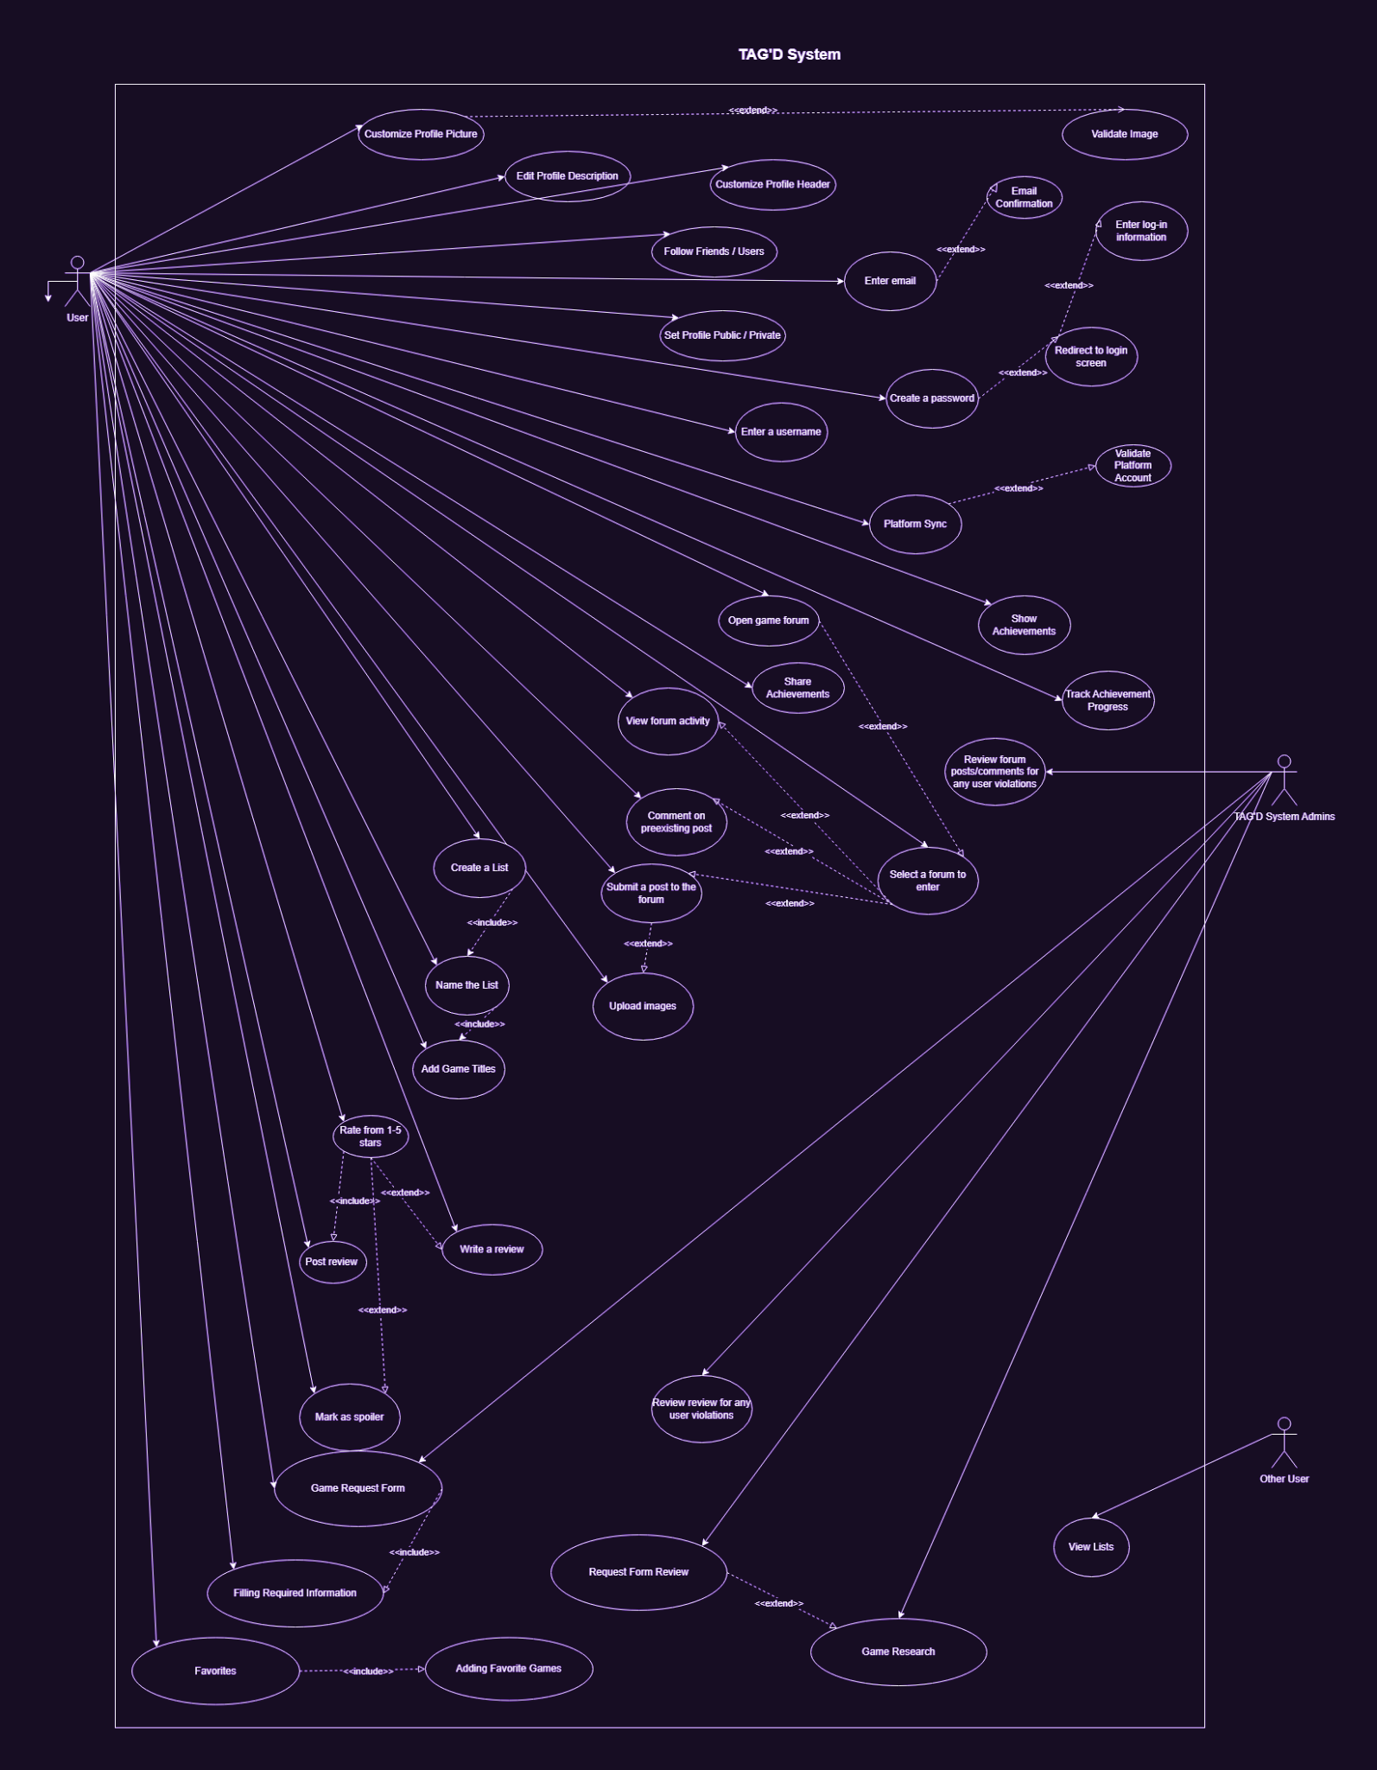
UCD:
OUR

Slide 9
CLOSER LOOK pt. 1
A

Slide 10
CLOSER LOOK pt. 2
A

Slide 11
CLOSER LOOK pt. 3
A

Slide 12
DESIGN CLASS DIAGRAM
03.
Notes:
CALEB / JON

Slide 13
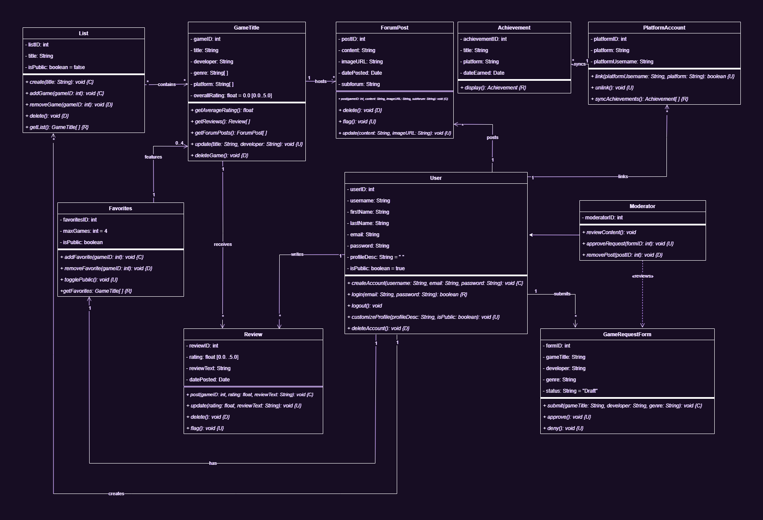
DCD:
OUR

Slide 14
LIST, GAMETITLE, FAVORITES
CLASSES:

Slide 15
REVIEW & USER
CLASSES:

Slide 16
FORUMPOST, ACHIEVEMENT, PLATFORM ACCOUNT
CLASSES:

Slide 17
MODERATOR & GAMEREQUESTFORM
CLASSES:

Slide 18
SEQUENCE DIAGRAMS
04.
Notes:
WESLEY / ISABEL

Slide 19
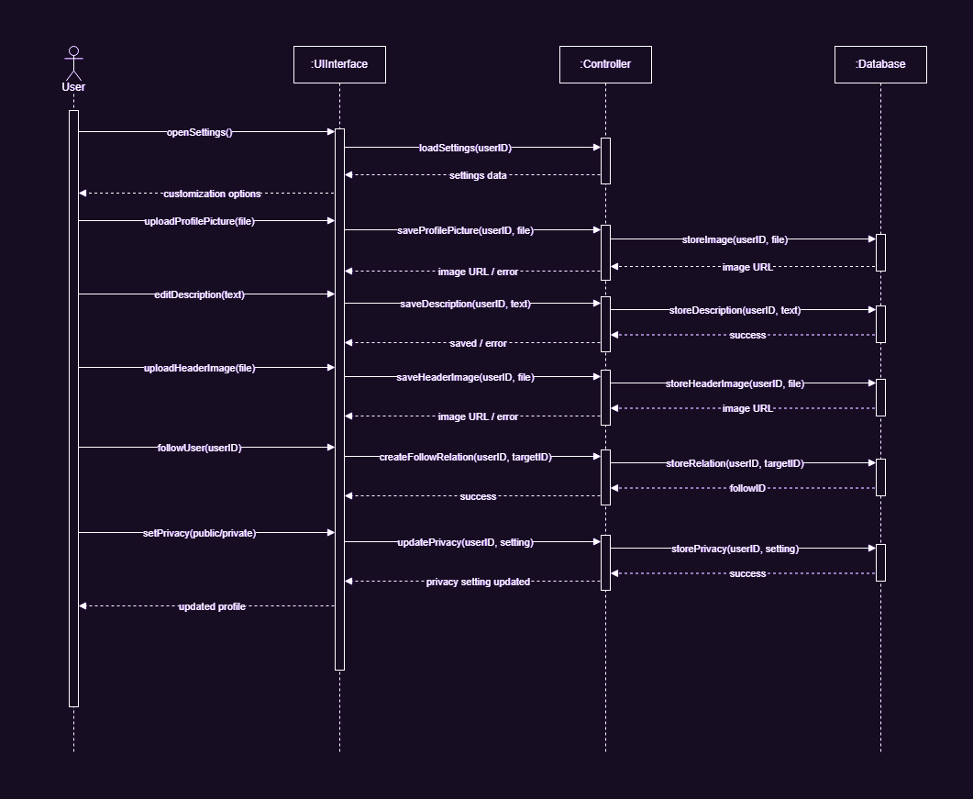
ACCOUNT CUSTOMIZATION
SSD 1:

Slide 20
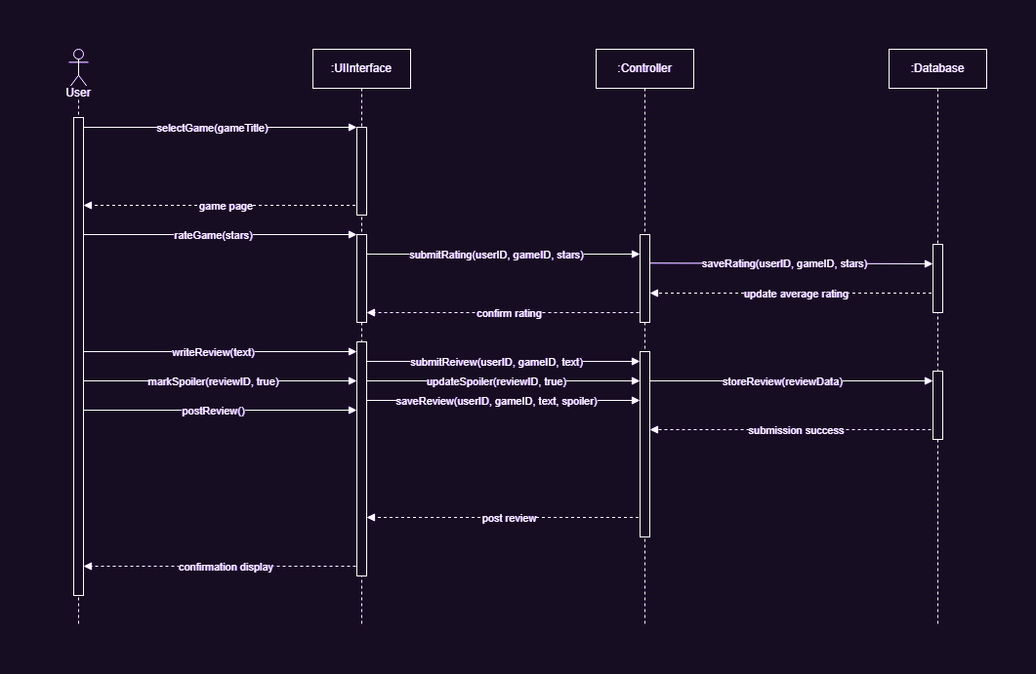
RATING/REVIEWING
SSD 2:

Slide 21
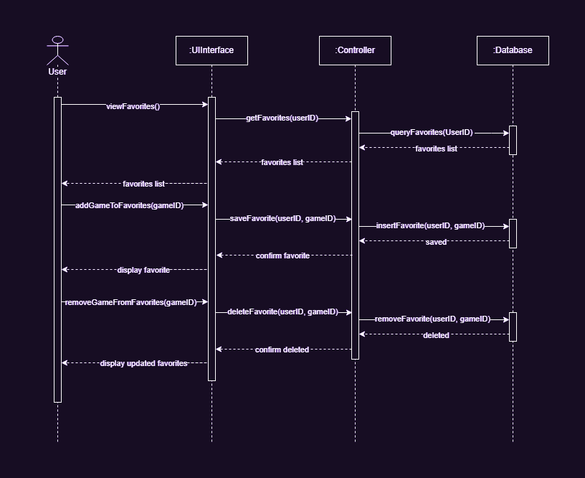
FAVORITES
SSD 3:

Slide 22
STATECHART
05.
Notes:
WESLEY

Slide 23
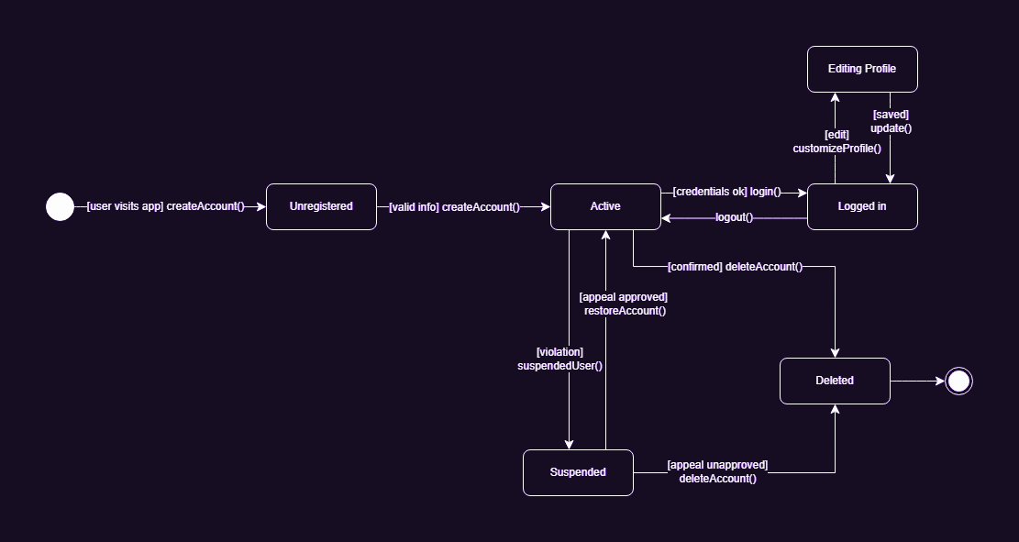
STATECHART:
USER

Slide 24
UI DESIGN
06.
Notes:
ISABEL

Slide 25
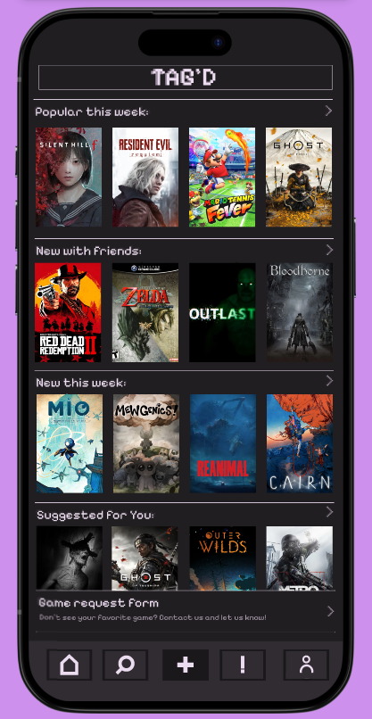
HOME PAGE
PAGE:

Slide 26
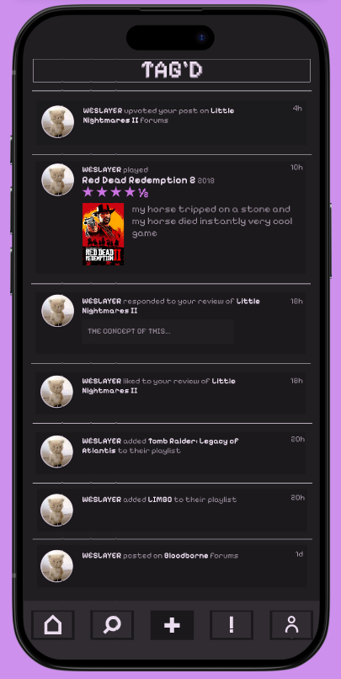
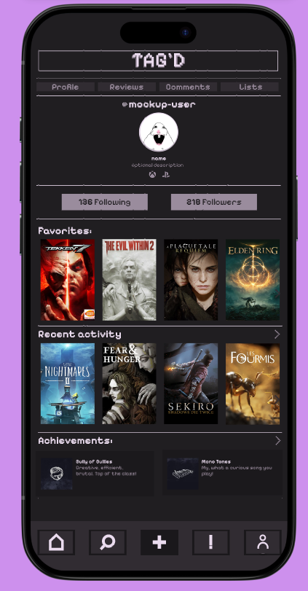
NOTIFICATIONS, USER PROFILE
PAGES:

Slide 27
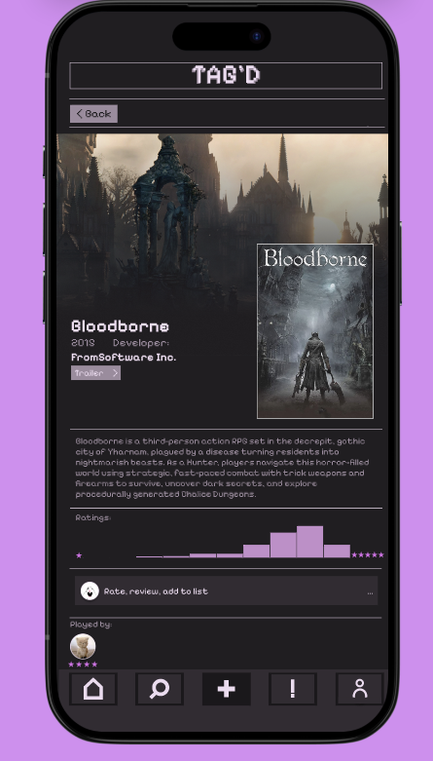
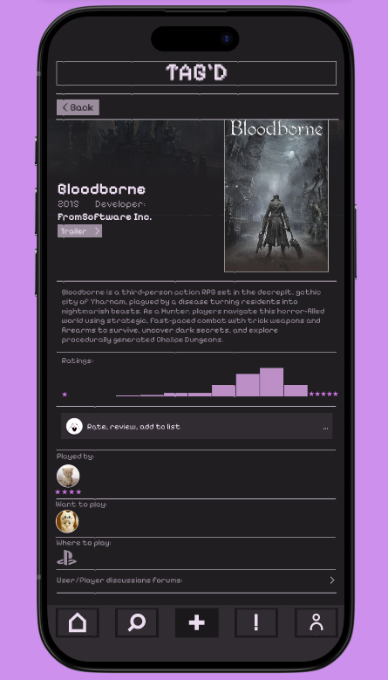
GAME INFO PAGE
PAGES:

Slide 28
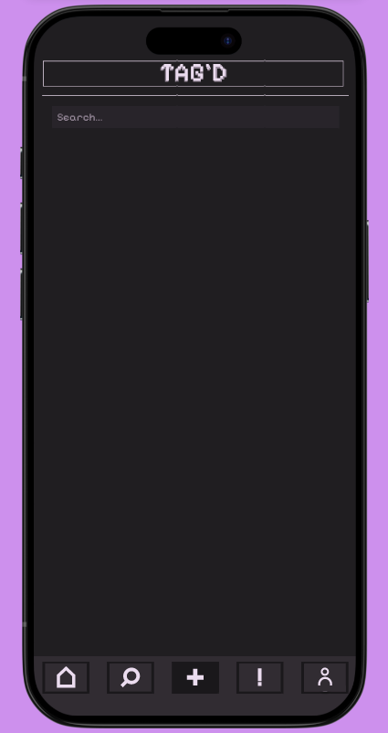
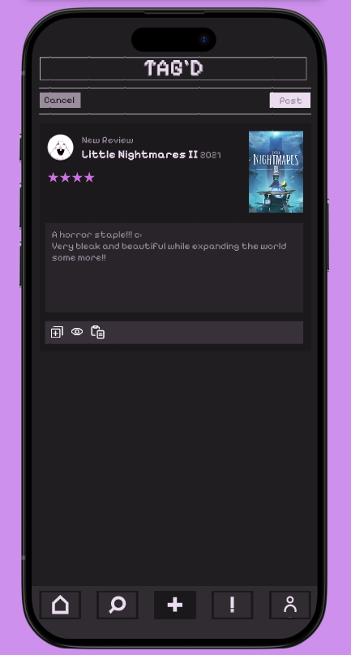
SEARCH, CREATE NEW POST
PAGES:

Slide 29
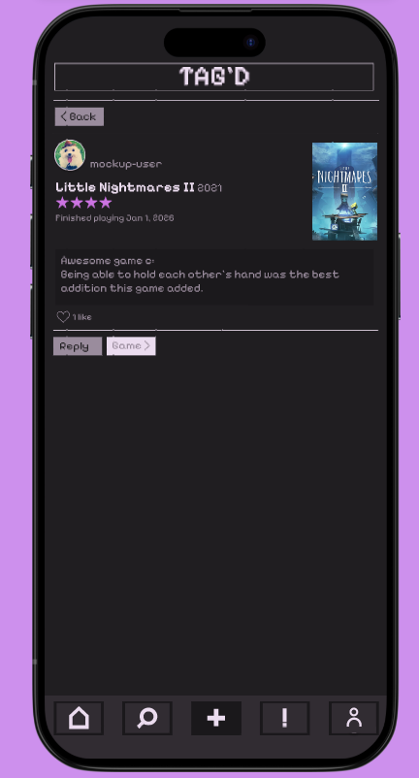
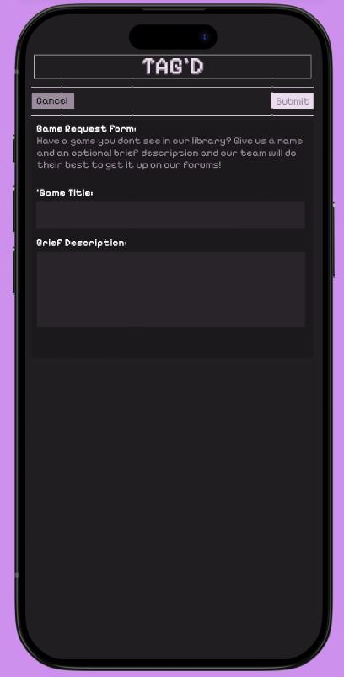
USER POST, GAME REQ FORM
PAGES:

Slide 30
WHATS NEXT?

Slide 31
STEPS
Stress testing
Test cases
User acceptance testing
— NEXT
Next steps
Next steps

Slide 32

THANKS!
Do you have any questions?

